Slide 1
JSON + Relational
Using Hybrid Data Models with MariaDB
Rob Hedgpeth, Developer Evangelist
MariaDB Corporation
Notes:
Introductions by Laura - welcome Rob
Thank you
Mention the title
Brief description of using JSON in a relational database
Briefly describe the agenda
Examples
Indexing
Creating constraints
Demo
“Will move quickly to save time for Q&A”

Slide 2

Agenda
Using Structured and Semi-structured Data
Why?
How?
Managing JSON Data
Reading
Writing
Indexing
Data Integrity
Demo
Q&A
JSON+Relational
Euphoria

Slide 3
Relational
JSON
Flexibility
Simplicity
Ubiquity
Data Integrity
Transactions
Reliability
Notes:
What is JSON and why use it?
JSON is fast becoming the standard format for data interchange and for unstructured data, and MariaDB Platform (in fact, all MariaDB versions 10.2 and later) include a range of JSON supporting functions.
JSON is great to work with. JSON is simple - very easy to use. Self-described. Human readability. Very easy to work with.
Very ubiquitous. Used everywhere.
There are concerns. If you’re a DBA - how can you be assured of data integrity.
Relational databases
Reliability - most of the world’s applications run on relational databases

Slide 4
What’s the difference?
Relational
JSON
[
{
“id”: 1,
“name”: “Pizza Hut”,
“type”: “R”
},
{
“id”: 2,
“name”: “Sears Tower”,
“type”: “A”
}
]
id | name | type
1 | Pizza Hut | R
2 | Sears Tower | A
Externally described
Self described

Slide 5
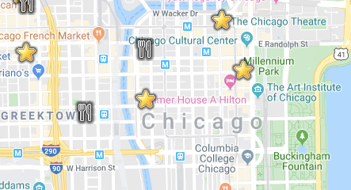
Structured or Semi-structured Data
Locations
Notes:
Latitudes and longitudes are numerical values and they are expressed in degrees. Latitude defines how far north (positive) or south (negative) of the equator a point is located. All points on the equator have a latitude value of zero. The north pole has a latitude of 90, and the south pole has a latitude of -90. So, that’s why all northern hemisphere locations have positive latitude and southern-hemisphere locations have negative values.
By definition, the Greenwich Observatory near London has a longitude of zero. Negative longitude means that this point is west of Greenwich, positive means that the point is east.

Slide 6
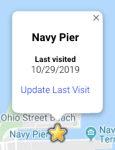
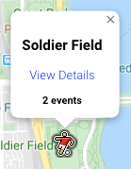
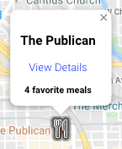
Structured or Semi-structured Data
Attractions
Restaurants
Sports Venues

Slide 7
So…?
AND
Structured or Semi-Structured Data
Notes:
Much like our chicken and waffles combination before, structured and semi-structured data can be used together. And much like chicken and waffles..the combination has amazing benefits.

Slide 8
Structured and Semi-structured Data
Structured
Semi-structured
name | type | latitude | longitude | attr
Lou Malnati’s | R | 42.0021628 | -87.7255662 | ‘{ “foodType”: “Pizza”, “menu”: “loumalnatis.com/our-menu” }’
Notes:
So, taking a look at a very simple example we can see a basic table setup...
Left side - structure relational data - defined in a schema - name columns
Right side - JSON data, unstructured

Slide 9
Creating and Querying
JSON Data

Slide 10
Handling JSON
CREATE TABLE locations (
id INT NOT NULL AUTO_INCREMENT,
name VARCHAR(100) NOT NULL,
type CHAR(1) NOT NULL,
latitude DECIMAL(9,6) NOT NULL,
longitude DECIMAL(9,6) NOT NULL,
attr JSON,
PRIMARY KEY (id)
);
TYPE ALIAS
Notes:
“The only thing that’s different is that last line”
JSON field is just an alias
It creates a text column
Adds a check constraint to validate the JSON data - every time it’s updated/changed

Slide 11
Handling JSON
SHOW CREATE TABLE locations;
CREATE TABLE locations (
id INT NOT NULL AUTO_INCREMENT,
name VARCHAR(100) NOT NULL,
type CHAR(1) NOT NULL,
latitude DECIMAL(9,6) NOT NULL,
longitude DECIMAL(9,6) NOT NULL,
attr LONGTEXT CHARACTER SET utf8mb4 COLLATE utf8mb4_bin DEFAULT NULL
CHECK (JSON_VALID(`attr`)
PRIMARY KEY (id)
);
Notes:
“The only thing that’s different is that last line”
JSON field is just an alias
It creates a text column
Adds a check constraint to validate the JSON data - every time it’s updated/changed

Slide 12
Handling JSON
JSON Data
Database Table
{
"category": "Landmark", "lastVisitDate": "11/10/2019"
}
id | name | ... | attr
1 | Loc 1 | ... | {...}
2 | Loc 2 | ... | [{...}]
3 | Loc 3 | ...
JSON_VALID( )
Notes:
“The only thing that’s different is that last line”
JSON field is just an alias
It creates a text column
Adds a check constraint to validate the JSON data - every time it’s updated/changed

Slide 13
Inserting Data
INSERT INTO locations (type, name, latitude, longitude, attr) VALUES ('R', 'Lou Malnatis', 42.0021628, -87.7255662,
'{"details": {"foodType": "Pizza", "menu": "https://www.loumalnatis.com/our-menu"},
"favorites": [{"description": "Pepperoni deep dish", "price": 18.75},
{"description": "The Lou", "price": 24.75}]}');
INSERT INTO locations (type, name, latitude, longitude, attr) VALUES ('A', 'Cloud Gate', 41.8826572, -87.6233039,
'{"category": "Landmark", "lastVisitDate": "11/10/2019"}');
Notes:
Nothing particularly out of the ordinary for inserts - the check constraint will validate

Slide 14
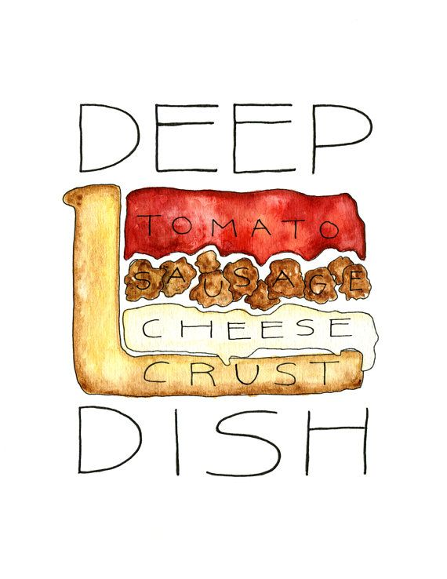
Reading Data
SELECT name, latitude, longitude,
JSON_VALUE(attr, '$.details.foodType') AS food_type
FROM locations
WHERE type = 'R';
name | latitude | longitude | food_type
Lou Malnati’s | 42.0021628 | -87.7255662 | Pizza
Notes:
Where it gets more interesting is using/reading the JSON data
Describe the data that is coming out
Background about how the data for type ‘R’ is different
Joke/mention about deep dish
The function takes the field that the JSON lives in (attr) and the path expression, which always starts with a dollar sign and then a path

Slide 15
Null Data
SELECT type, name, latitude, longitude,
JSON_VALUE(attr,'$.details.foodType') AS food_type
FROM locations;
type | name | latitude | longitude | food_type
R | Lou Malnati’s | 42.0021628 | -87.7255662 | Pizza
A | Willis Tower | 41.8788764 | -87.6359149 | NULL
Notes:
Immediately, if you’re like me, you’re wondering what would happen if we remove the type filter? What happens when the JSON doesn’t exist?
Query will not break, you’ll just get NULL

Slide 16
Contains Path
SELECT name, latitude, longitude,
JSON_VALUE(attr, '$.details.menu') AS menu
FROM locations
WHERE type = 'R' AND
JSON_CONTAINS_PATH(attr, 'all', '$.details.menu',
'$.details.foodType') = 1;
name | latitude | longitude | menu
Lou Malnati’s | 42.0021628 | -87.7255662 | https://www.loumalnatis.com...
Notes:
Only want to get Restaurants that have a particular field - consider using a different example - replace with MENU
Just checking if field exists

Slide 17
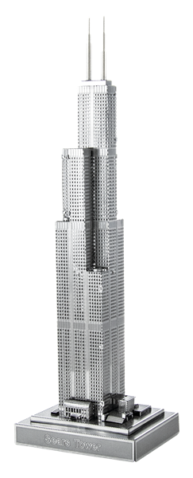
Contains Value
SELECT name, latitude, longitude
FROM locations
WHERE type = 'A' AND
JSON_CONTAINS(attr, '\"Landmark\"', '$.category') = 1;
name | latitude | longitude
Willis Tower | 41.8788764 | -87.6359149
Notes:
Checking to see if a particular value is there

Slide 18

JSON Filtering
SELECT id, name, latitude, longitude
FROM locations
WHERE type = 'S' AND
JSON_VALUE(attr, '$.details.yearOpened') = 1924;
id | name | latitude | longitude
7 | Soldier Field | 41.8623132 | -87.6166884
Notes:
We can return data based on the JSON data of a specific field
Use an explicit field value

Slide 19
Reading JSON Objects
SELECT name, description,
JSON_QUERY(attr, '$.details') AS details
FROM locations
WHERE type = 'R'
name | description | details
The Publican | An award winning American style restaurant | { "foodType": "American", "menu": "thepublicanrestaurant.com/menu" }
Notes:
Talked about fields and arrays
Now move to objects
Comes back as a “small” JSON doc

Slide 20
Reading Arrays
SELECT name, description,
JSON_QUERY(attr, '$.teams') AS home_teams
FROM locations
WHERE type = 'S';
name | description |  | home_teams
United Center | An indoor arena on the Near West Side of Chicago |  | [ "Bulls", "Blackhawks" ]
Notes:
Scalar values - > JSON_VALUE
Array/object values -> JSON_QUERY

Slide 21
Reading array elements
SELECT name, description,
JSON_VALUE(attr, '$.teams[0]') AS primary_home_team
FROM locations
WHERE type = 'S';
name | description |  | primary_home_team
United Center | An indoor arena on the Near West Side of Chicago |  | Bulls
Notes:
We can also read particular values within an array
Specifying the position in the array to get the correct element
Maybe we can assume the first value will be the primary home team for the sports venue. Maybe they actually own the building.

Slide 22
Reading objects
SELECT name,
JSON_QUERY(attr, '$.teams') AS home_teams,
JSON_QUERY(attr, '$.details') AS details
FROM locations
WHERE type = 'S';
name | home_teams |  | details
United Center | [ "Bulls", "Blackhawks" ] |  | { "capacity": 23500, "yearOpened": 1994 }
Notes:
All the examples thus far have just returned one piece of data from a JSON doc
We can do much more than that

Slide 23
Indexing (1/2)
ALTER TABLE locations ADD COLUMN
food_type VARCHAR(25) AS (JSON_VALUE(attr, '$.details.foodType')) VIRTUAL;
EXPLAIN SELECT name, latitude, longitude
FROM locations
WHERE food_type = 'Mexican';
id | select_type | table | type | possible_keys
1 | SIMPLE | locations | ALL | NULL
Notes:
May not be practical to look in a JSON doc for every row.
But we’re going to want to get some indexing, where it makes sense, to help improve performance.
The bottom query here simply shows that we don’t (yet) have an index for our search. So, we’re going to go into EVERY attr value to search.
So, let’s add a virtual column to index -
The bottom query just shows that we’re not using an index. We’re going into every JSON doc to search.
A virtual column will look just like any other column, but isn’t persistent. It just gives us the option to query it.
You don’t have to use JSON function… can just get to it directly
<next slide>

Slide 24
Indexing (2/2)
CREATE INDEX foodtypes ON locations(food_type);
EXPLAIN SELECT name, latitude, longitude
FROM locations
WHERE food_type = 'Mexican';
id | select_type | table | ref | possible_keys
1 | SIMPLE | locations | ref | foodtypes
Notes:
2.) We can create an index on our virtual column
So, if we run that same bottom query we now have an index (see bottom)
Now we can use the “foodtypes” index to narrow down our search criteria.

Slide 25
Modifying JSON documents
Notes:
Modifying fields, adding elements to an array, etc.

Slide 26
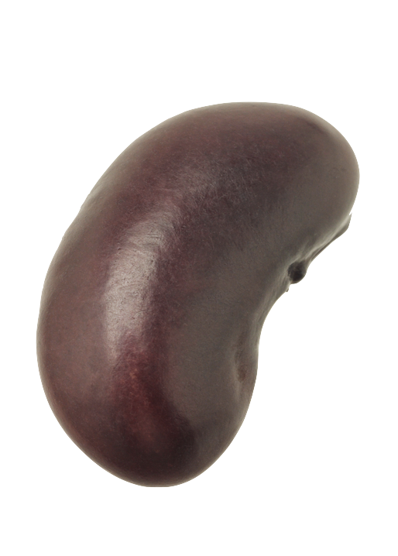

Inserting fields
UPDATE locations
SET attr = JSON_INSERT(attr,
'$.nickname',
'The Bean')
WHERE id = 8;
SELECT name,
JSON_VALUE(attr, '$.nickname') AS nickname
FROM locations
WHERE type = 'A';
name | nickname
Cloud Gate | The Bean
Notes:
Great things about JSON is that we get the ability to change the structure on the fly.
“Oh you know what…I can add another field”...

Slide 27
Inserting array
UPDATE locations
SET attr = JSON_INSERT(attr,
'$.foodTypes',
JSON_ARRAY('Asian', 'Mexican'))
WHERE id = 1;
SELECT name,
JSON_QUERY(attr, '$.foodTypes')
AS food_types
FROM locations
WHERE id = 1;
name | food_types
Saucy Porka | [ "Asian", "Mexican" ]
Notes:
We may also want to add an array.
We can do that by using two functions for this example:
We create an array using the JSON_ARRAY function
Then we can pass that array into JSON_INSERT to add our array to the JSON document

Slide 28
Adding array elements
UPDATE locations
SET attr = JSON_ARRAY_APPEND(attr,
'$.foodTypes', 'German’)
WHERE id = 1;
SELECT name, format, price,
JSON_QUERY(attr, '$.foodTypes')
AS food_types
FROM locations
WHERE id = 1;
name | food_types
Saucy Porka | [ "Asian", "Mexican", "German"]
Notes:
May want to add elements to an array - definitely possible!
Maybe a restaurant decides to do another fusion. For better or worse.

Slide 29
Removing array elements
UPDATE locations
SET attr = JSON_REMOVE(attr,
'$.foodTypes[2]')
WHERE id = 1;
SELECT name,
JSON_QUERY(attr, '$.foodTypes')
AS food_types
FROM locations
WHERE id = 1;
name | food_types
Saucy Porka | [ "Asian", "Mexican]
Notes:
Specify the index

Slide 30
Hybrid Data Querying
Notes:
The examples so far have been pretty simple. So, let’s ramp things up a bit.

Slide 31
Returning relational data as JSON
SELECT
JSON_OBJECT('name', name, 'latitude', latitude, 'longitude', longitude) AS data
FROM locations
WHERE type = 'S';
data
{ "name": "Wrigley Field", "latitude": 41.9484384, "longitude": -87.6553327 }
Notes:
Even if you don’t have JSON in your database you can still return data as JSON using JSON_OBJECT
As long as you have a set of name/value pairs - can return properly formed JSON
For some applications we can just return JSON docs. For some cases that may make more sense than actually storing JSON

Slide 32
Relational + JSON
SELECT
JSON_OBJECT('name', name, 'latitude', latitude, 'longitude', longitude, 'capacity',
JSON_VALUE(attr, '$.details.capacity')) AS data
FROM locations
WHERE type = 'S';
data
{ "name": "Wrigley Field", "latitude": 41.9484384, "longitude": -87.6553327 “capacity": 41649 }
Notes:
We can even combine both schema (structured) data and JSON (unstructured) data into a single new JSON doc to return

Slide 33
Merging Relational and JSON Data
SELECT
JSON_MERGE(
JSON_OBJECT(
'name', name,
'latitude', latitude,
'Longitude', longitude),
attr) AS data
FROM locations
WHERE type = 'R';
data
{ "name": "The Publican", "latitude": 42.676388, "longitude": -87.678740, "details": { "foodType": "American", "menu": "http://www.thepublicanrestaurant.com/menu"}, "favorites": [ {"description": "Ribs with fries", "price": 16.99}, {"description": "BBQ Burger", "price": 12.99} ] }
Notes:
We can even merge
The example in the last slide is essentially flat. It was intended to support more a flat structure.
Something more complex
Still use JSON-OBJECT to create JSON from our structured data
BUT then we can merge with a more complex JSON doc
The different between the last example and this one is that we’re getting a much more complex result back with this examples
The takeaway here is that you have quite a bit of flexibility. You can tailor it to your requirements.
Tangent
You can go to either end of the spectrum.
Only a little JSON
A lot of JSON
Best place might be someplace in the middle.
As data matures might more into structured from JSON

Slide 34

JSON to Tabular Data
SELECT l.name, d.food_type, d.menu
FROM
locations AS l,
JSON_TABLE(l.attr,
‘$’ COLUMNS(
food_type VARCHAR(25) PATH ‘$.foodType’,
menu VARCHAR(200) PATH ‘$.menu’)
) AS d
WHERE id = 2;
MariaDB 10.6
name | food_type | menu
Giordano’s | Pizza | http://giordanos.com/menu
Notes:
We can even merge
The example in the last slide is essentially flat. It was intended to support more a flat structure.
Something more complex
Still use JSON-OBJECT to create JSON from our structured data
BUT then we can merge with a more complex JSON doc
The different between the last example and this one is that we’re getting a much more complex result back with this examples
The takeaway here is that you have quite a bit of flexibility. You can tailor it to your requirements.
Tangent
You can go to either end of the spectrum.
Only a little JSON
A lot of JSON
Best place might be someplace in the middle.
As data matures might more into structured from JSON

Slide 35
Enforcing Data Integrity
Notes:
The last bit to cover in respect to the SQL functions - data integrity
MariaDB 10.2 we introduced check constraints

Slide 36
JSON Constraints
ALTER TABLE locations ADD CONSTRAINT check_attr
CHECK(
type != 'S' OR (type = 'S' AND
JSON_TYPE(JSON_QUERY(attr, '$.details')) = 'OBJECT' AND
JSON_TYPE(JSON_QUERY(attr, '$.details.events')) = 'ARRAY' AND
JSON_TYPE(JSON_VALUE(attr, '$.details.yearOpened')) = 'INTEGER' AND
JSON_TYPE(JSON_VALUE(attr, '$.details.capacity')) = 'INTEGER' AND
JSON_EXISTS(attr, '$.details.yearOpened') = 1 AND
JSON_EXISTS(attr, '$.details.capacity') = 1 AND
JSON_LENGTH(JSON_QUERY(attr, '$.details.events')) > 0));
Notes:
Check constraints
(10.2) Support functions that enforce check constraints
Added JSON functions
Put those two together we can constrain JSON data
Constraints help to verify reliable data in an unstructured world
If it’s not a sports venue, I’m not concerned. If it IS a sports venue then I’ve added several constraints here (as an example) to enforce data integrity within our JSON doc
Here you’re seeing several new JSON functions. There are over two dozen JSON functions.

Slide 37
JSON Constraints
INSERT INTO locations (type, name, latitude, longitude, attr)
VALUES ('S', 'Wrigley Field', 41.9484384, -87.6553327,
'{"details": {"yearOpened": 1914, "capacity": 41649}');
ERROR 4025 (23000): CONSTRAINT `check_attr` failed for `demo`.`locations`
No events field!
Notes:
Explain the error
No resolution field for this JSON
Check constraint failed

Slide 38
JSON Constraints
INSERT INTO locations (type, name, latitude, longitude, attr)
VALUES ('S', 'Wrigley Field', 41.9484384, -87.6553327,
'{"details": {"yearOpened": "Last Year", "capacity":
41649}, "teams": ["Cubs"]');
ERROR 4038 (HY000): Syntax error in JSON text in argument 1 to function 'json_type' at position 1
"Last Year" is not a number!
Notes:
The value doesn’t align
The error is actually about the function. It didn’t receive the value it was expecting.
The function was expecting a value, but didn’t get the correct input.

Slide 39
DEMO

Slide 40
The Tip of the Iceberg
JSON_ARRAY
JSON_ARRAYAGG
JSON_ARRAY_APPEND
JSON_ARRAY_INSERT
JSON_COMPACT
JSON_CONTAINS
JSON_CONTAINS_PATH
JSON_DEPTH
JSON_DETAILED
JSON_EXISTS
JSON_EXTRACT
JSON_INSERT
JSON_KEYS
JSON_LENGTH
JSON_LOOSE
JSON_MERGE_PATCH
JSON_MERGE_PRESERVE
JSON_OBJECT
JSON_OBJECTAGG
JSON_QUERY
JSON_QUOTE
JSON_REMOVE
JSON_REPLACE
JSON_SEARCH
JSON_SET
JSON_TABLE
JSON_TYPE
JSON_UNQUOTE
JSON_VALID
JSON_VALUE
Notes:
https://mariadb.com/kb/en/json-functions/
Data type (alias): https://mariadb.com/kb/en/json-data-type/

Slide 41


Developer Hub
https://mariadb.com/developers
Tutorials
Blog posts
Webinars
Toolkits

Slide 42

GO ANYWHERE WITH SKYSQL
THE ULTIMATE MARIADB CLOUD
https://mariadb.com/skyview
SkySQL is the first and only DBaaS capable of deploying MariaDB as a:
Distributed SQL database for scalable transaction processing
Multi-master cluster for continuous availability
Multi-node columnar database for data warehousing and analytics
$500 Credit!

